Slide 1
DAY6- TABLEAU
Interactive Dashboard Creation
-Mamatha Ramanujam

Slide 2
Scenarios
Build dashboard to show some insights.
Arrange Your Dashboard.
Remove the subcategory filter option to vacate the space.
Remove the year of order filter option to vacate the space.
Select Profit color legend and drag it to Sales in the South.
Make your dashboard interactive.
One by one click all the states in the profit map having negative profit and check both profit and sales for each state.
Rename your dashboard and save as Regional Sales and Profit.

Slide 3
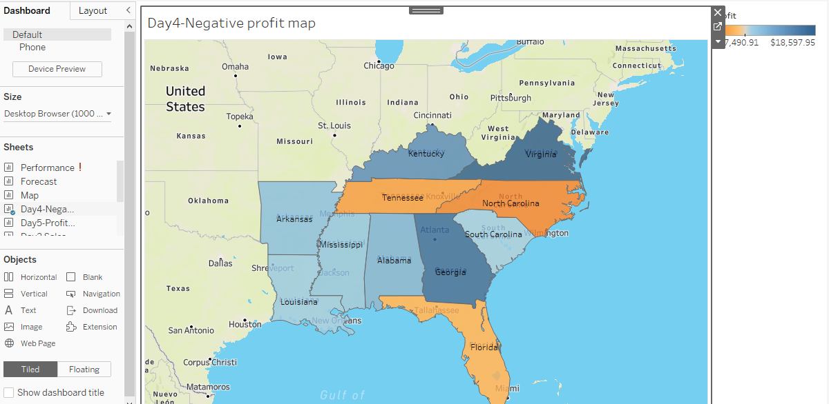
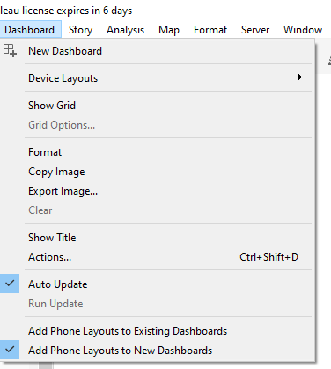
Build dashboard to show some insights
Step1: Select New Dashboard→ Blank layout will be seen
Select the required sheet for dashboard creation → Day4-Negative profit worksheet

Slide 4
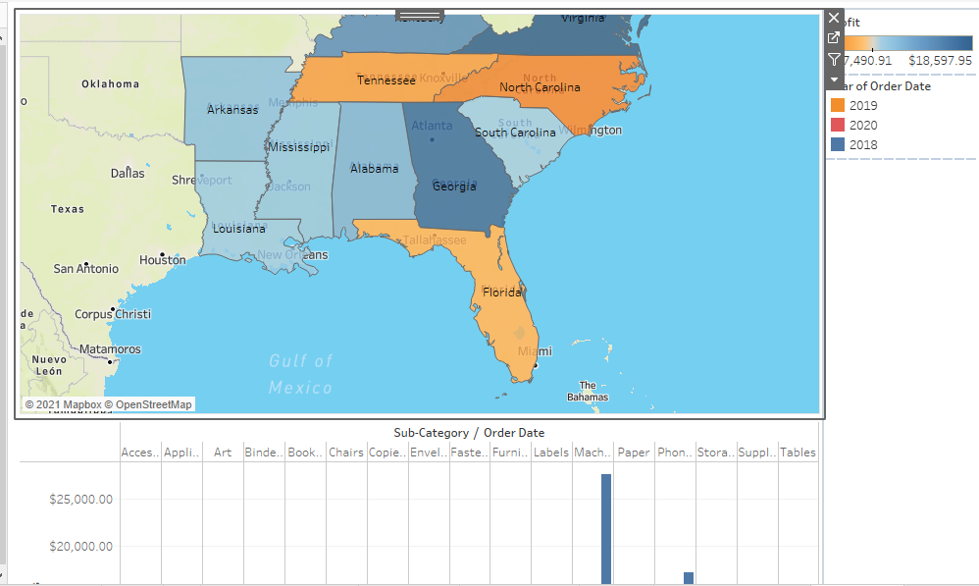
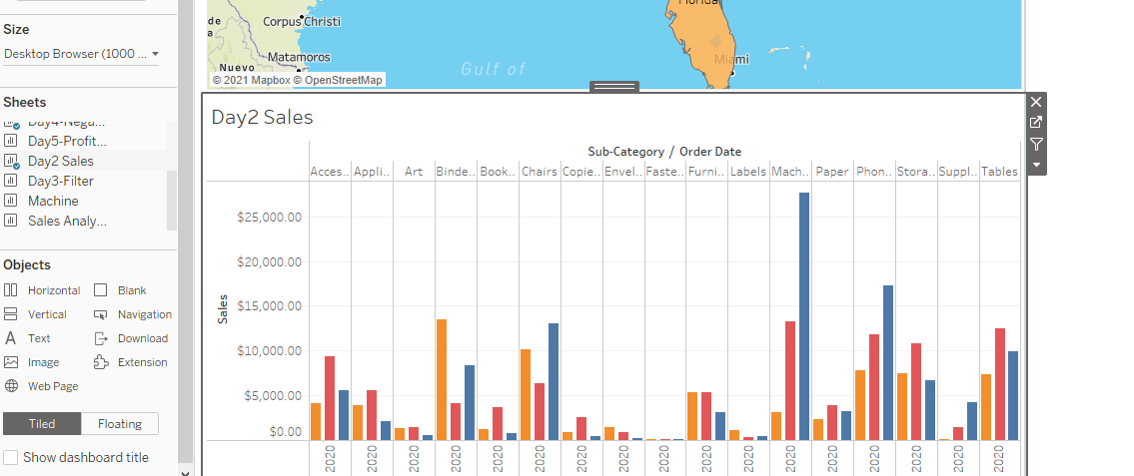
Arrange Your Dashboard
Step2: Arrange the dashboard accordance to space alignment and remove hide titles

Slide 5
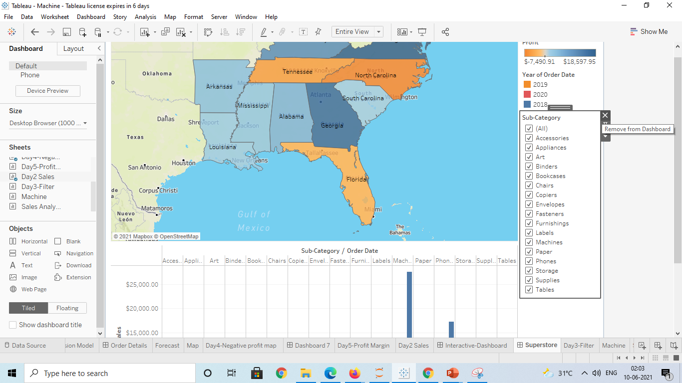
Remove the subcategory filter option to vacate the space
Step3:Removing the Sub category filter from the dashboard tools to vacate the space by clicking ‘X’ button

Slide 6
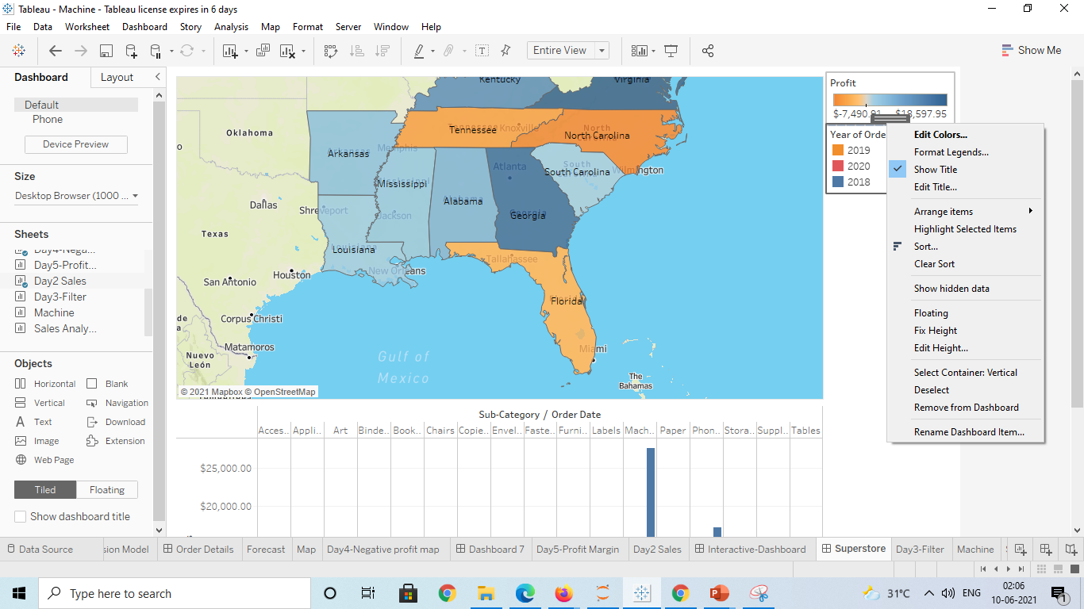
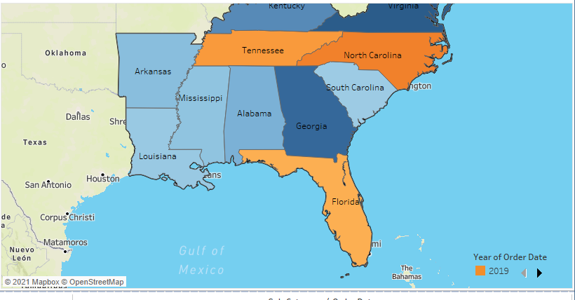
Remove the year of order filter option to vacate the space
Step4: Right click the year filter and click Floating option to make the bar float and rearrange/sort according to convenance

Slide 7
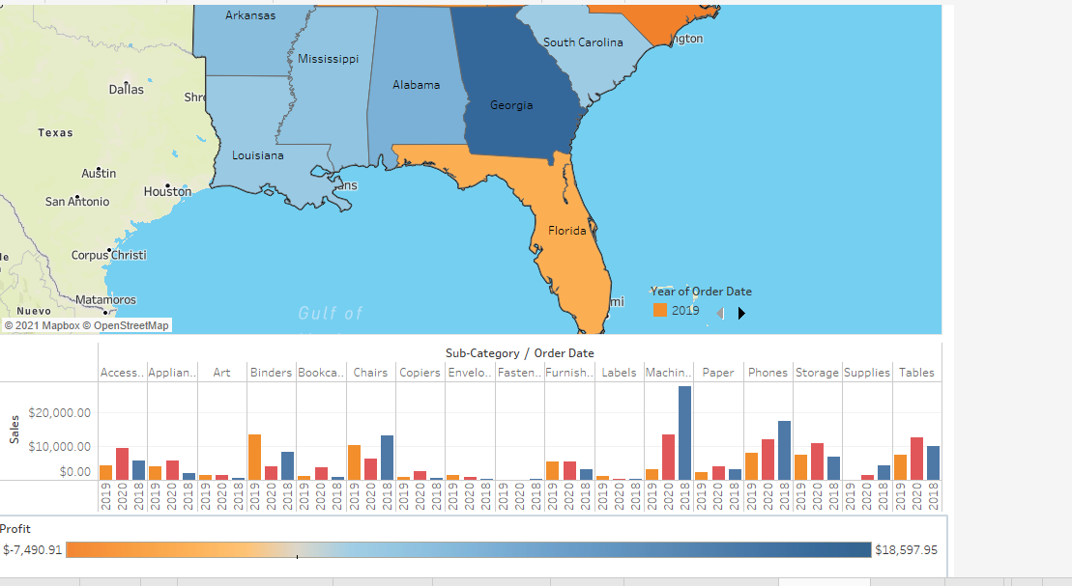

Select Profit color legend and drag it to Sales in the South
Step5: Drag the profit filter from pane and drop it horizontally in the last under sales

Slide 8
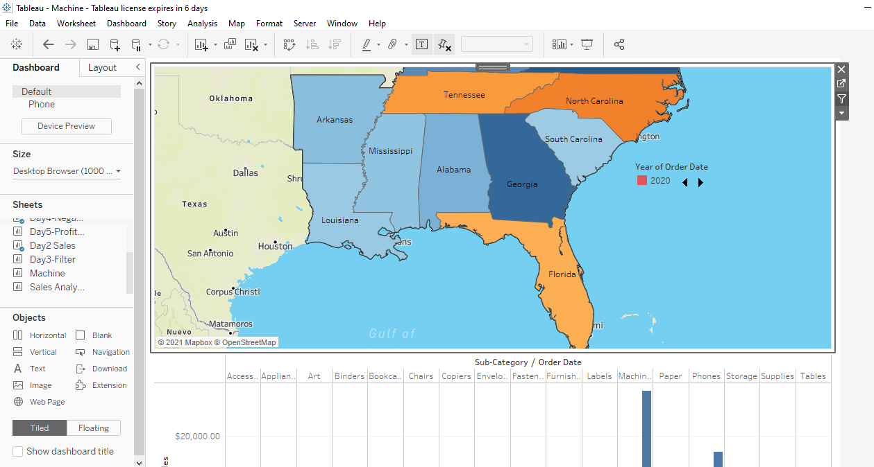
Make your dashboard interactive
Step6: Select the filter option for dashboard interactive with other worksheet

Slide 9
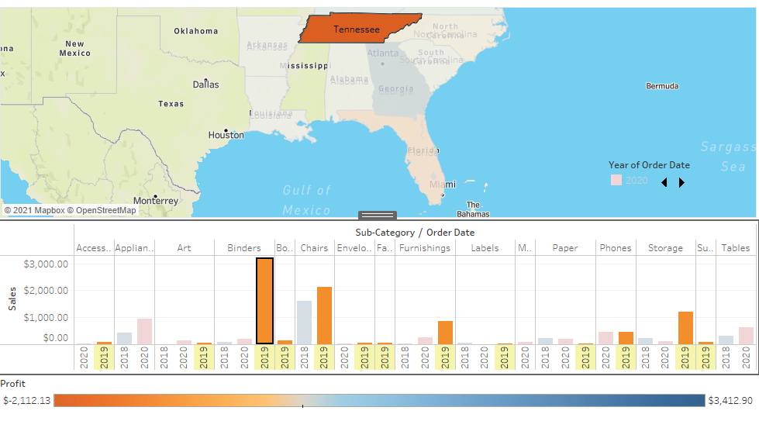
One by one click all the states in the profit map having negative profit and check both profit and sales for each state
Step7: Select every state on geographical map and see the change in highlights of Sales
For example Tennessee shows 2019 sub category sales of Binders which is of negative profit

Slide 10
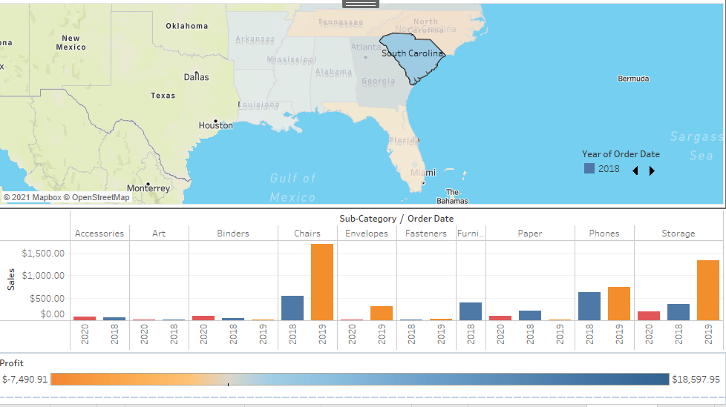
South Carolina

Slide 11
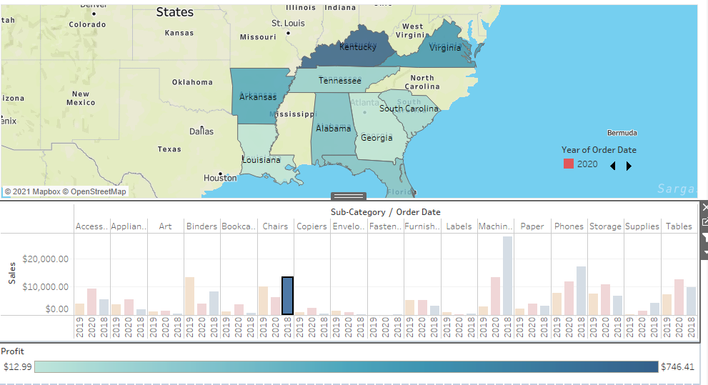
Selecting Sales Bar instead of state which shows the chairs sale profit on each state

Slide 12
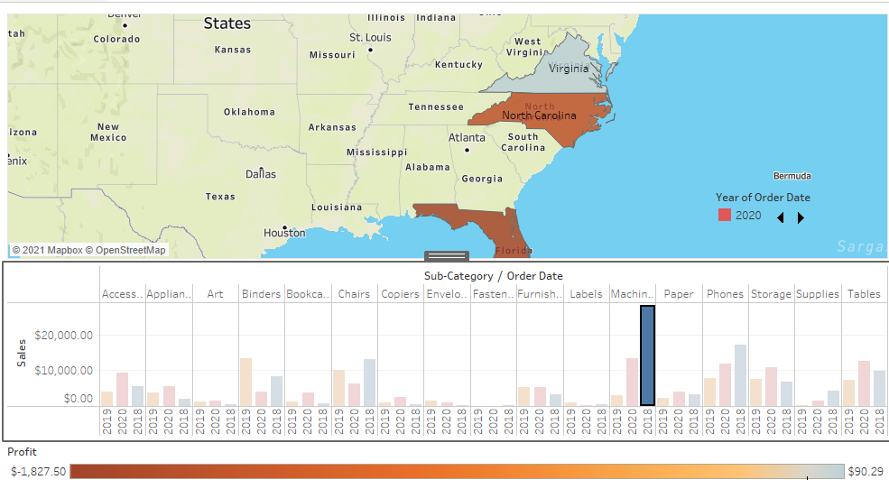
Sub category Machine purchase in 2018 → Negative profit on 2 countries North Caolina and Florida

Slide 13
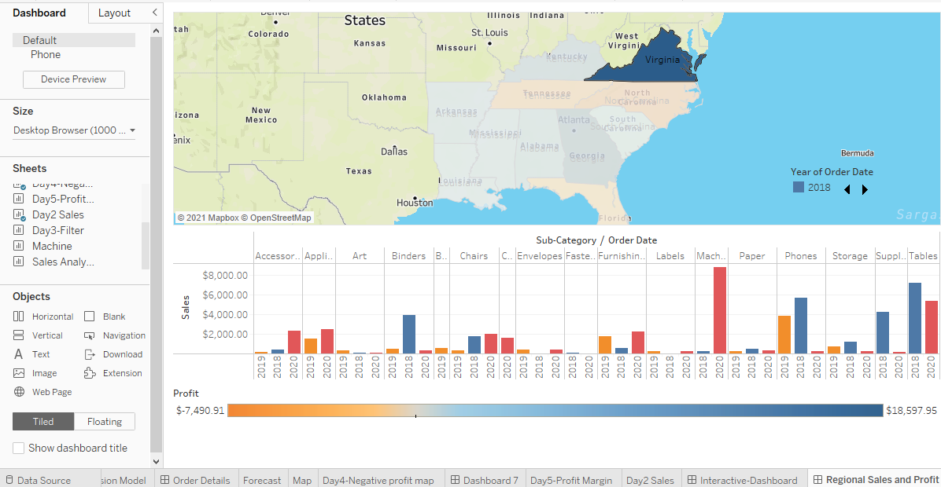
Rename your dashboard and save as Regional Sales and Profit

